Slide 1
L21: Conclusion

Slide 2
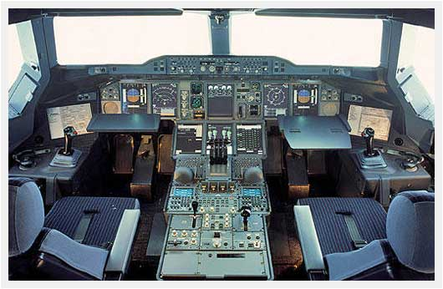
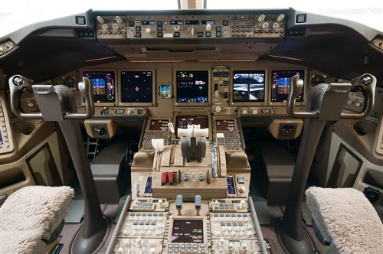
UI Hall of Fame or Shame?
Air France 447 crash (2009)
Airbus A330 cockpit
side stick controller
Boeing 777 cockpit
control yoke
Notes:
no angle-of-attack indicator
screens going blank from lack of accurate information
side stick vs. yoke
http://www.telegraph.co.uk/technology/9231855/Air-France-Flight-447-Damn-it-were-going-to-crash.html

Slide 3
Today’s Topics
Course recap
Group project madness
What to do next

Slide 4
User Interfaces Are Hard to Design
You are not the user
Most software engineering is about communicating with other programmers
UI is about communicating with users
The user is always right
Consistent problems are the system’s fault
…but the user is not always right
Users aren’t designers

Slide 5
Iterative Design
UI development is an iterative process
Any risky design problem (UI or not) should be approached iteratively
Design
Evaluate
Implement

Slide 6
Spiral Model
Use throw-away prototypes and cheap evaluation for early iterations
Design
Evaluate
Implement

Slide 7
Usability Is Multidimensional
Usability = how well users can use the system’s functionality
Learnability: is it easy to learn and remember?
Efficiency: once learned, is it fast to use?
Safety: are errors few and recoverable?
Dimensions differ in importance
Depending on users and tasks

Slide 8
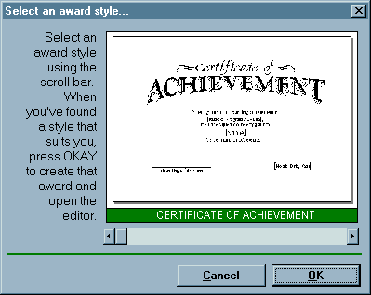
Learnability
Consistency
Metaphor
Affordance
Mapping
Speak the user’s language

Slide 9
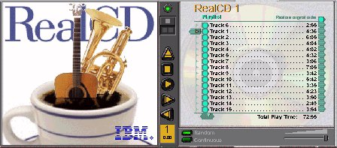

Learnability
Visible affordances
Information scent
Visible state
Locus of attention
Feedback
mouse over

Slide 10
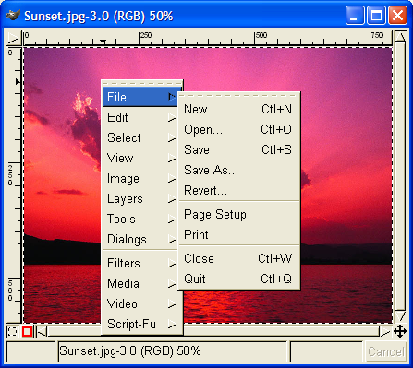
Efficiency
Fitts’s Law
Steering Law
Shortcuts
History
Aggregation

Slide 11
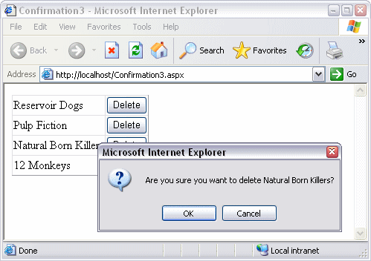
Safety
Modes
Slips
Lapses
Memory burden
Error messages

Slide 12
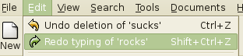
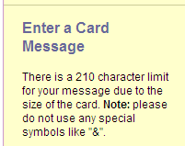
Safety
Cancel
Undo
CRUD
No arbitrary data limits

Slide 13
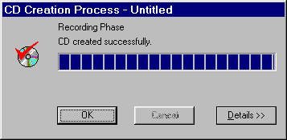
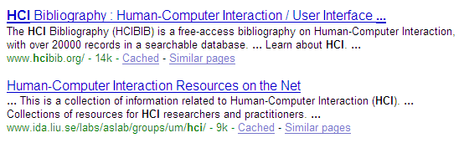
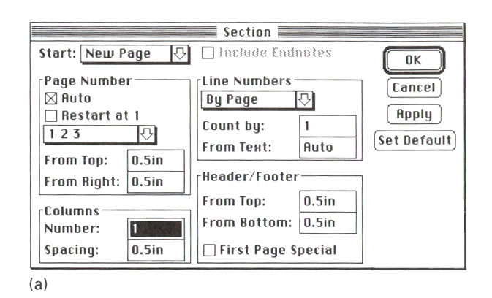
Graphic Design & Layout
Color design
Typography
Simplicity
Visual variables
White space
Gestalt grouping
Alignment
Balance & symmetry

Slide 14
Design Techniques
User & task analysis
Design sketches
Storyboards
Paper prototypes
Computer prototypes
Wizard of Oz prototypes

Slide 15
Evaluation Techniques
Keystroke-level models
Formative user testing
Heuristic evaluation
Controlled experiments

Slide 16
Implementation Techniques
GUI toolkits come and go
HTML/CSS/Javascript/jQuery today
Who knows what’s coming tomorrow
Remember what to look for in a GUI toolkit
View hierarchy
Component, stroke, pixel output
Input event handling
Automatic layout
Internationalization
Accessibility

Slide 17
Nanoquiz
go to shoutkey.com/pantry
3 minutes (timer in the upper right)
closed book
closed notes
no talking
no email/FB/IM
be a good person
make your mother proud
Notes:
non-cert URL: shoutkey.com/transmit

Slide 18
Madness
Go to shoutkey.com/pantry to vote for your favorite project

Slide 19
Awards

Slide 20
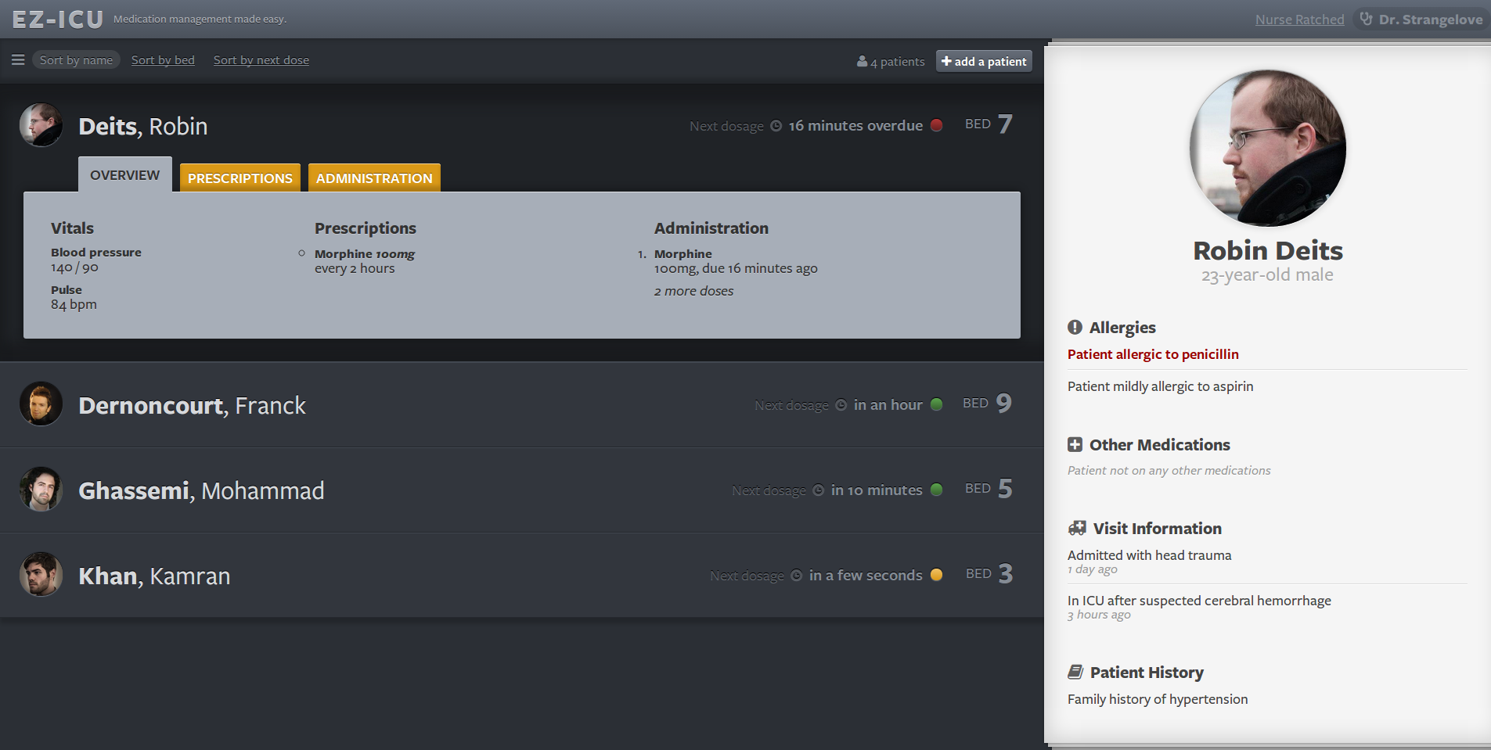
Award for Minimalism
EZ-ICU
Robin Beits, Franck Dernoncourt, Mohammed Ghassemi, Kamran Khan

Slide 21
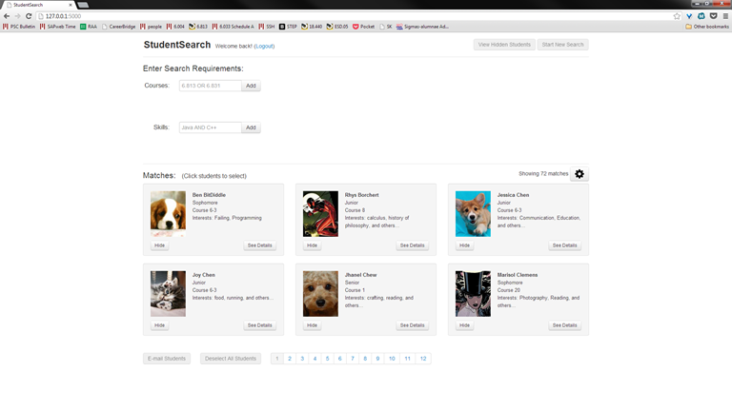
Award for Self-Disclosure
StudentSearch Jessica Chen, Chris Dessonville, Tanya Liu, Sarah Scodel

Slide 22
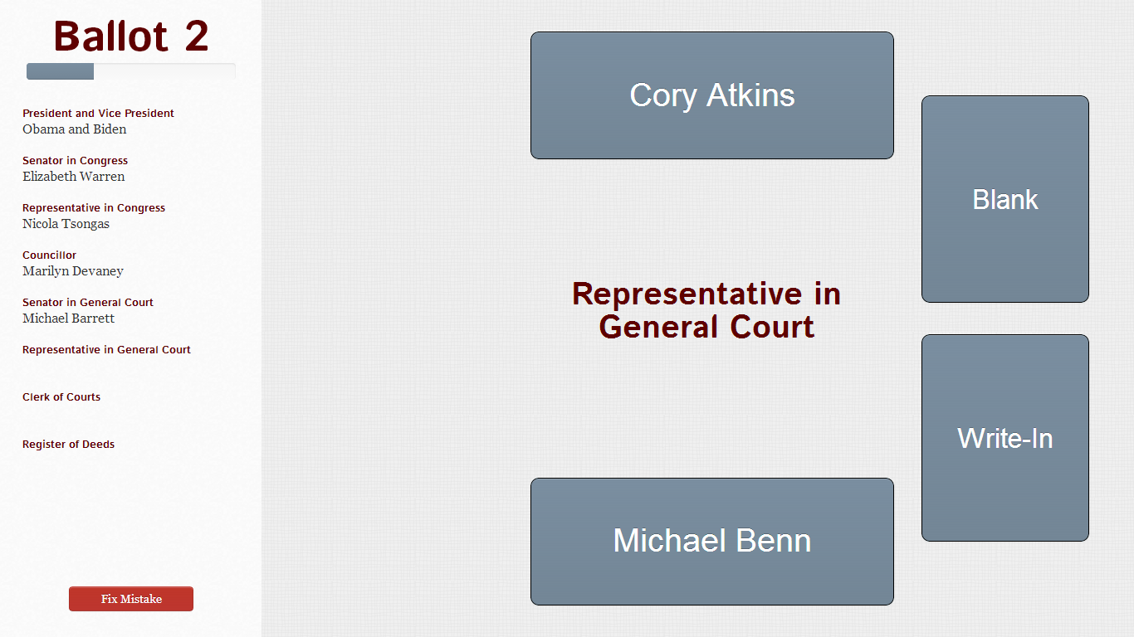
Award for Stretch Population
TrueVote Ayesha Bose, Harshini Jayaram, Alvaro Morales, Rachael Naphtal

Slide 23
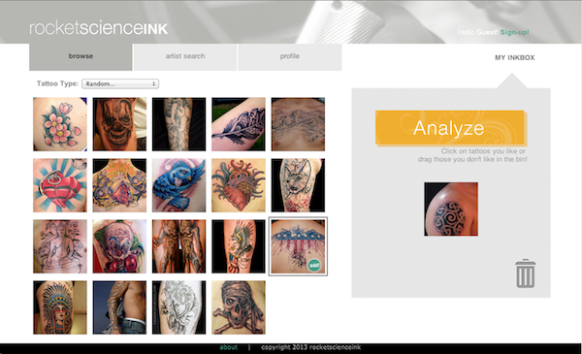
Award for Creative Concept
RocketScienceInk
Gao Guangyan, Ronnachai Jaroensri, Kevin Wong

Slide 24
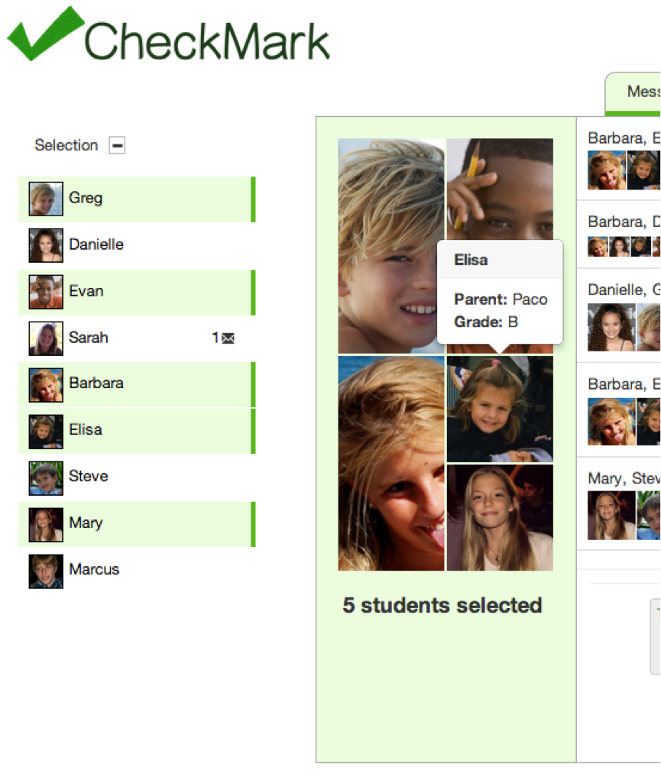
Award for Selection & Feedback
CheckMark
Marcus Lowe, Elisa Castaner, Evan Marshall, Danielle Olson

Slide 25
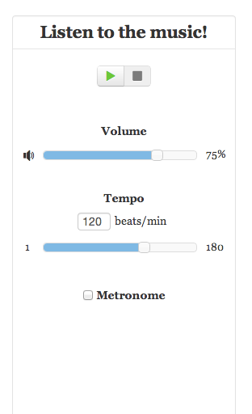
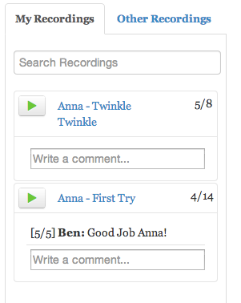
Award for Multimedia
Pitch Perfect
Ge (Jackie) Chen, Irene Chen, Jiashan (Susan) Liang

Slide 26
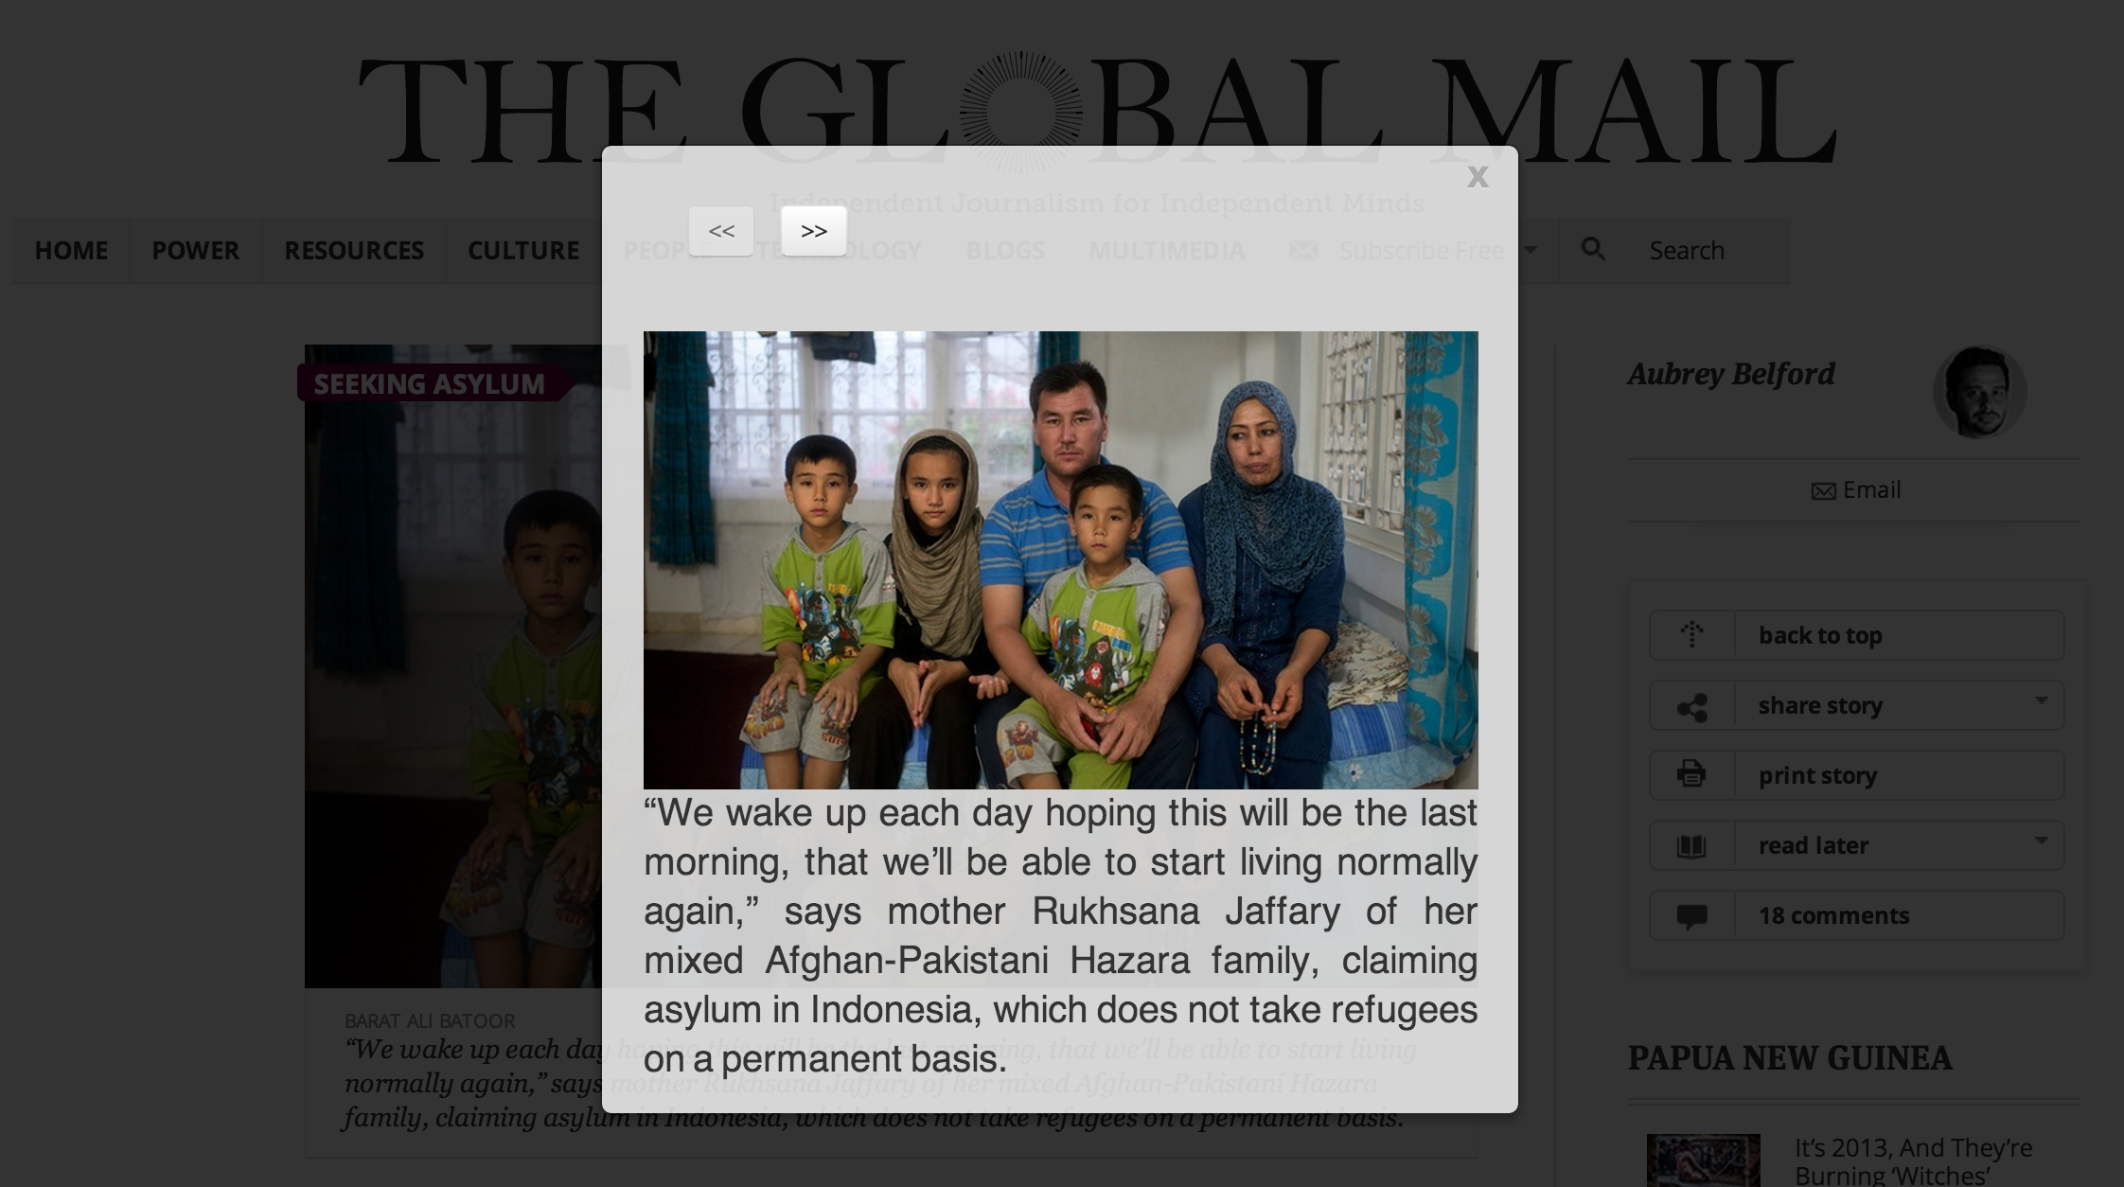
Award for Assistive Technology
Refocus.io
Anvisha Pai, Kai Liao, Jake Bograd-Denton, Max Kolysh

Slide 27
People’s Choice Award
???

Slide 28
What To Do Next: Courses
6.835 Intelligent Multimodal Interfaces
6.079 Engineering Innovation and Design
16.470J Statistical Methods in Experimental Design
6.470 IAP Web Programming Contest
6.570 IAP Mobile Programming Contest
MAS.672 New Paradigms for HCI
MAS.834 Tangible Interfaces
MAS.630 Affective Computing
MAS.712 Creative Learning Technologies
...and many other Media Lab courses

Slide 29
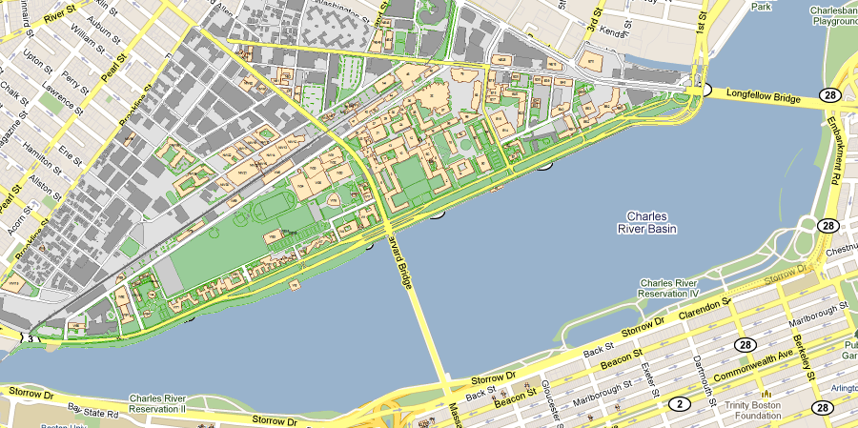

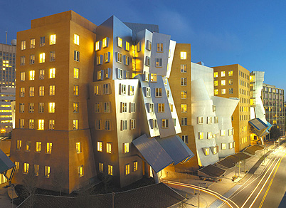
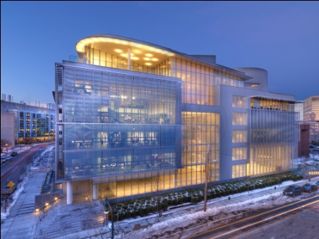

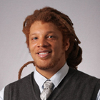



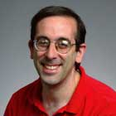





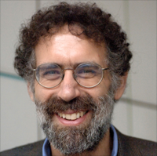






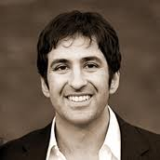

The MIT HCI Landscape
for your next UROP, Super-UROP, AUP, or MEng

Slide 30
Top Grad Schools in HCI
MIT
EECS or Media Lab
CMU
HCII or CSD
Stanford
Berkeley
UW
CSE or iSchool
Northwestern
EECS or TSB
plus Maryland, Georgia Tech, Illinois, Cornell

Slide 31
Final Thoughts
Not just human-computer interaction
Any artifact or system with human users has a user interface
We’re all users
Have respect and compassion for the people you design for
Treat them as you want other designers to treat you
Consider tradeoffs
Usability is rarely the only consideration
Make the world better for all of us
Notes:
A building, a research paper, a slide presentation, a book, a parking lot, a wiki page...
... all pose UI design problems... have particular users with particular tasks... and can be tackled with UI design principles and user-centered design (cheap prototyping, evaluation).

Slide 32
...And Please Evaluate Your Courses
Go to http://web.mit.edu/subjectevaluation
Evaluations close on Monday at 9 am

